Slide 1
Comment Asciidoctor peut vous aider pour votre doc
Jeremie.Bresson@bsi-software.com

Slide 2
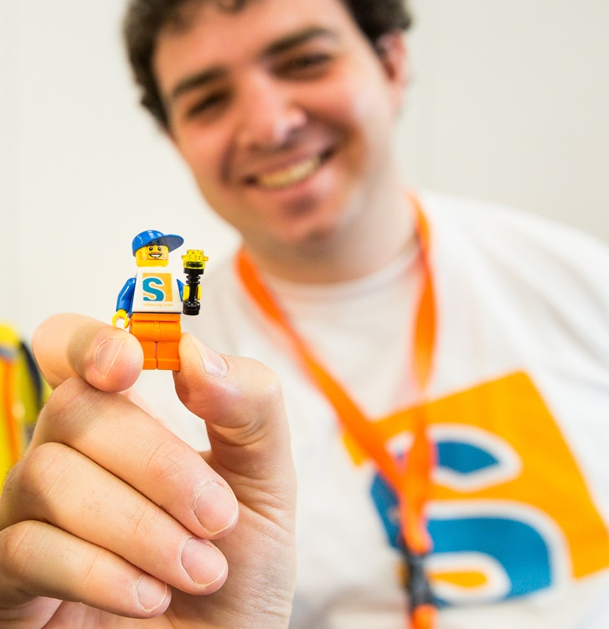



Bio
Software developer
@j2r2b
+JeremieBresson
jmini
Occasional open-source contributor:
Eclipse Scout
Asciidoctor
Mylyn Wikitext
…

Slide 3
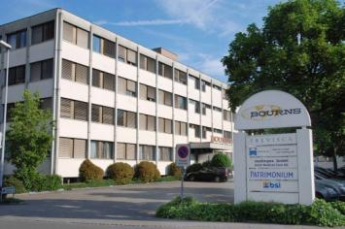


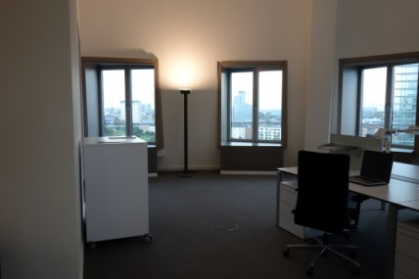
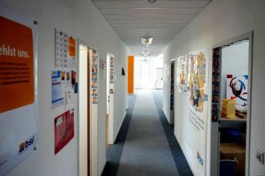
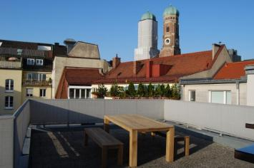

BSI AG
Baar
Baden
Bern
Düsseldorf
Frankfurt
Munich
Zurich

Slide 4
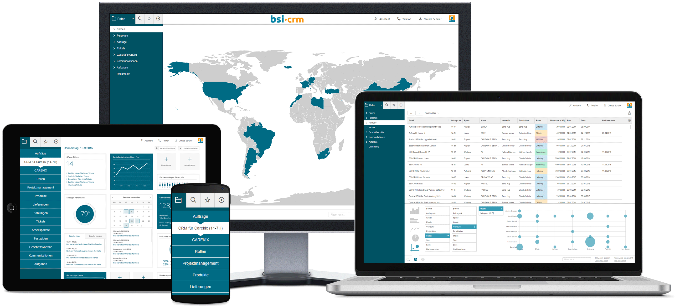
BSI CRM

Slide 5


Eclipse Scout
@Order(1000)
public class FirstNameField extends AbstractStringField {
@Override
protected String getConfiguredLabel() {
return TEXTS.get("FirstName");
}
}
www.eclipse.org/scout

Slide 6

Asciidoctor
Asciidoctor is a publishing toolchain for the AsciiDoc writing format.
Written in Ruby (and transpiled to JavaScript) (can be used with JRuby in the JVM)
Open Source (MIT Licence)

Slide 7
AsciiDoc example
= Getting Started with Java
Author Name <author@example.org>
== Hello World example
Copy the *HelloWorld.java* file.
TIP: The application prints _Hello World!_ to the console.
* Compile this source to a class file using `javac`.
* Run the compiled class file using `java`.
If you need help with the Java syntax check the link:http://docs.oracle.com/javase/8/docs/[Java 8 Javadoc].

Slide 8
Headings
hackers
= Getting Started with Java
Author Name <author@example.org>
== Hello World example
Copy the *HelloWorld.java* file.
TIP: The application prints _Hello World!_ to the console.
* Compile this source to a class file using `javac`.
* Run the compiled class file using `java`.
If you need help with the Java syntax check the link:http://docs.oracle.com/javase/8/docs/[Java 8 Javadoc].
Document Title
Section Level 1

Slide 9
Lists
= Getting Started with Java
Author Name <author@example.org>
== Hello World example
Copy the *HelloWorld.java* file.
TIP: The application prints _Hello World!_ to the console.
* Compile this source to a class file using `javac`.
* Run the compiled class file using `java`.
If you need help with the Java syntax check the link:http://docs.oracle.com/javase/8/docs/[Java 8 Javadoc].
Unorder list items

Slide 10
Inline formatting
= Getting Started with Java
Author Name <author@example.org>
== Hello World example
Copy the *HelloWorld.java* file.
TIP: The application prints _Hello World!_ to the console.
* Compile this source to a class file using `javac`.
* Run the compiled class file using `java`.
If you need help with the Java syntax check the link:http://docs.oracle.com/javase/8/docs/[Java 8 Javadoc].
bold
italic
code

Slide 11
Links
= Getting Started with Java
Author Name <author@example.org>
== Hello World example
Copy the *HelloWorld.java* file.
TIP: The application prints _Hello World!_ to the console.
* Compile this source to a class file using `javac`.
* Run the compiled class file using `java`.
If you need help with the Java syntax check the link:http://docs.oracle.com/javase/8/docs/[Java 8 Javadoc].
Link with title

Slide 12

Admonition
= Getting Started with Java
Author Name <author@example.org>
== Hello World example
Copy the *HelloWorld.java* file.
TIP: The application prints _Hello World!_ to the console.
* Compile this source to a class file using `javac`.
* Run the compiled class file using `java`.
If you need help with the Java syntax check the link:http://docs.oracle.com/javase/8/docs/[Java 8 Javadoc].

Slide 13
AsciiDoc example
= Getting Started with Java
Author Name <author@example.org>
== Hello World example
Copy the *HelloWorld.java* file.
TIP: The application prints _Hello World!_ to the console.
* Compile this source to a class file using `javac`.
* Run the compiled class file using `java`.
If you need help with the Java syntax check the link:http://docs.oracle.com/javase/8/docs/[Java 8 Javadoc].

Slide 14
Pour se lancer
Débuter avec Asciidoctor (article en français) http://asciidoctor.org/news/2016/04/05/debuter-avec-asciidoctor/
Les CastCodeur Podcast – Episode 144 http://lescastcodeurs.com/

Slide 15
Thanks
@j2r2b
+JeremieBresson
jmini
jeremie.bresson@bsi-software.com

